Slide 1
COSEE-TEK TEACHER TECHNOLGY EXPERIENCE: A CATALYST FOR LEARNING AND COMMUNICATING OCEAN SCIENCE AND TECHNOLOGY
Ivar Babb, NURTEC; Diana Payne, CT Sea Grant; Lauren Rader, Project Oceanology; Kelly Matis, Sea Research Foundation; Michael McKee, NURTEC

Slide 2
Outline
COSEE-TEK Overview
Teacher Technology Experiences (TTEs)
Educational Resource Development
Results of TTE Evaluation

Slide 3
How We Think of the Ocean in Space & Time – Henry Stommel, 1963
From Vance and Doel, 2010

Slide 4
Biological Oceanography in Space & Time
Haury et al. 1978

Slide 5
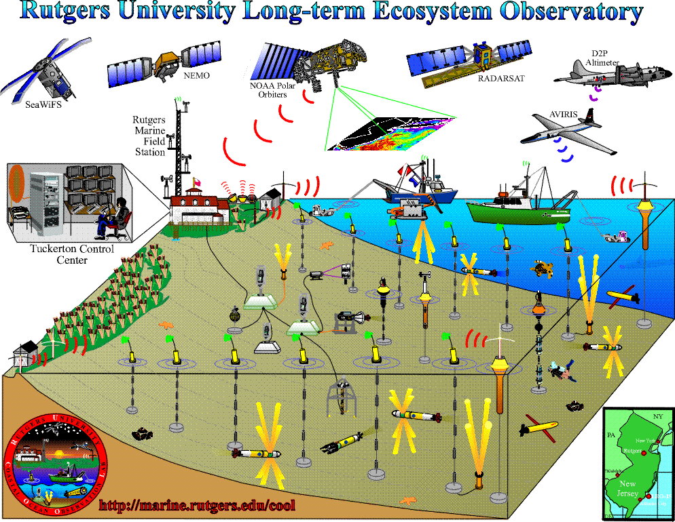
Technologies to Study the Ocean in Multiple Dimensions
Rutgers University Institute of Marine and Coastal Sciences

Slide 6
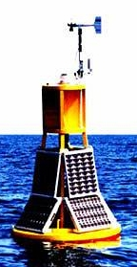
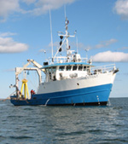
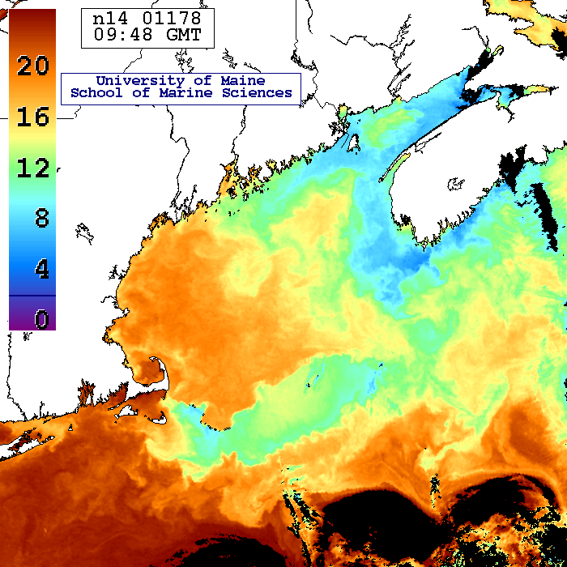
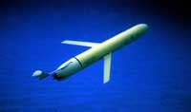
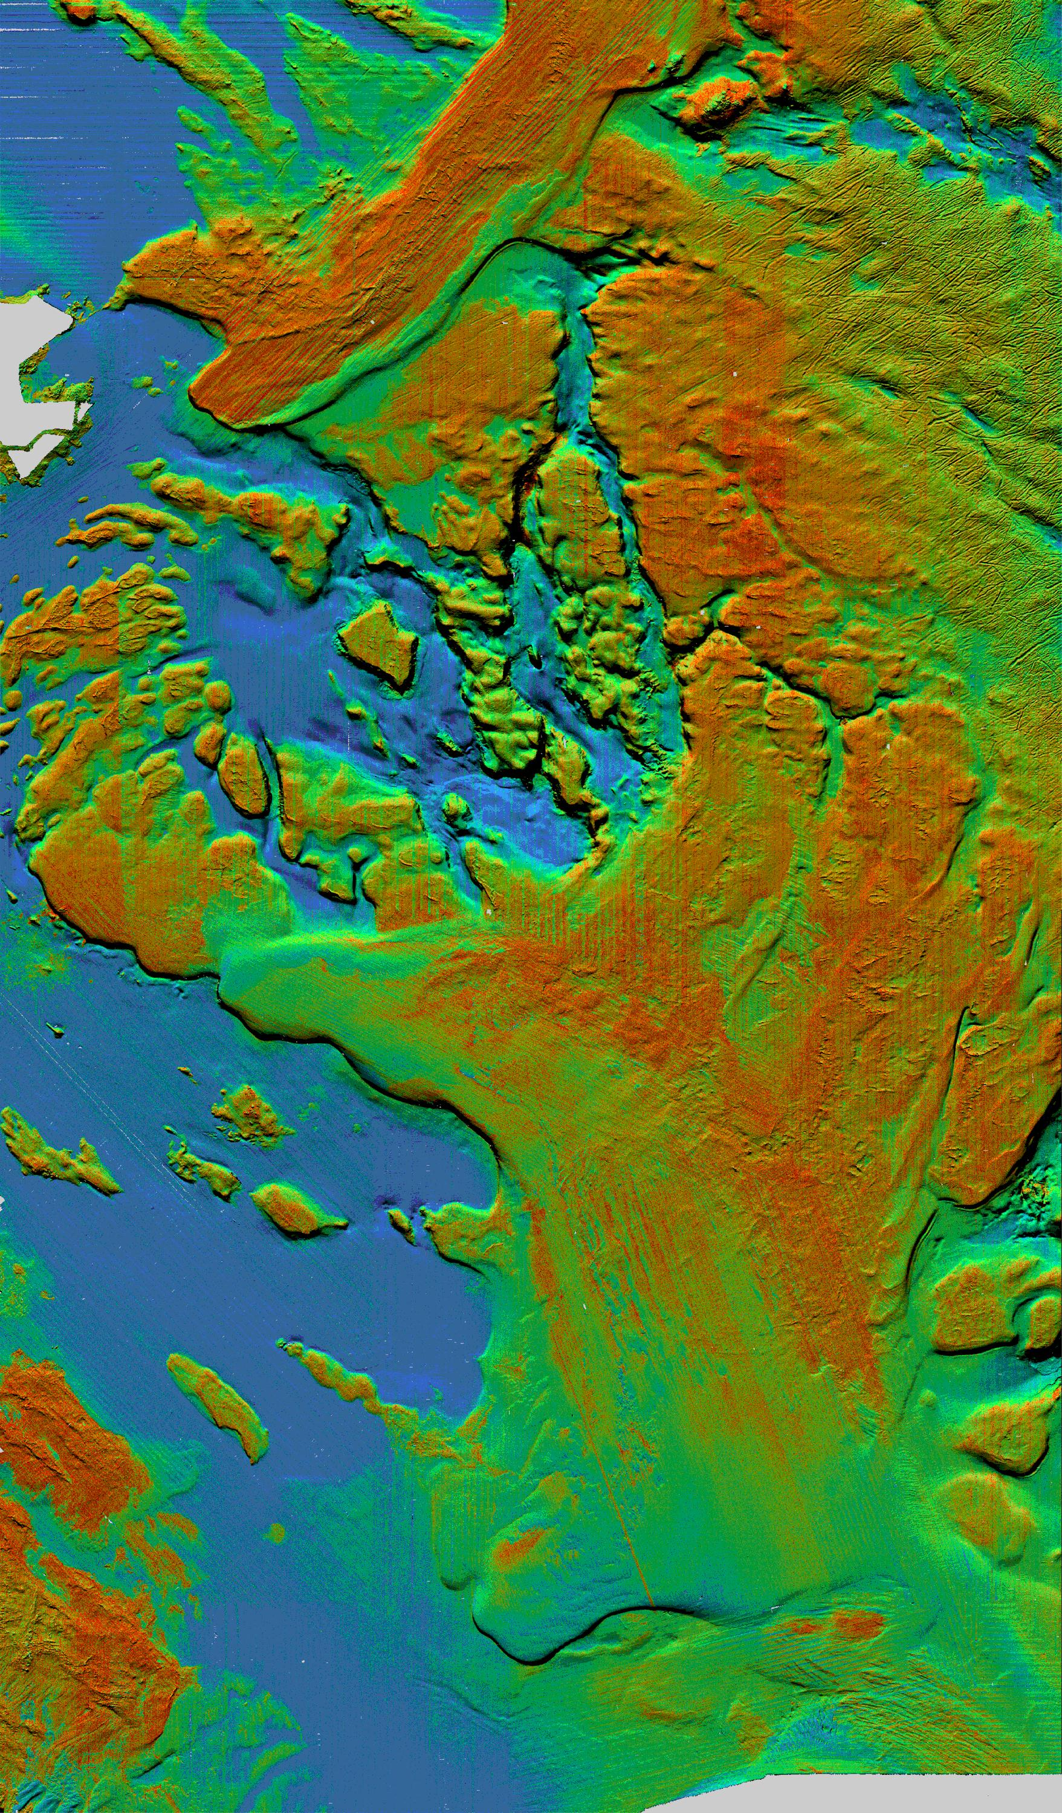
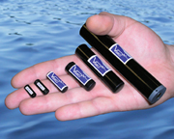
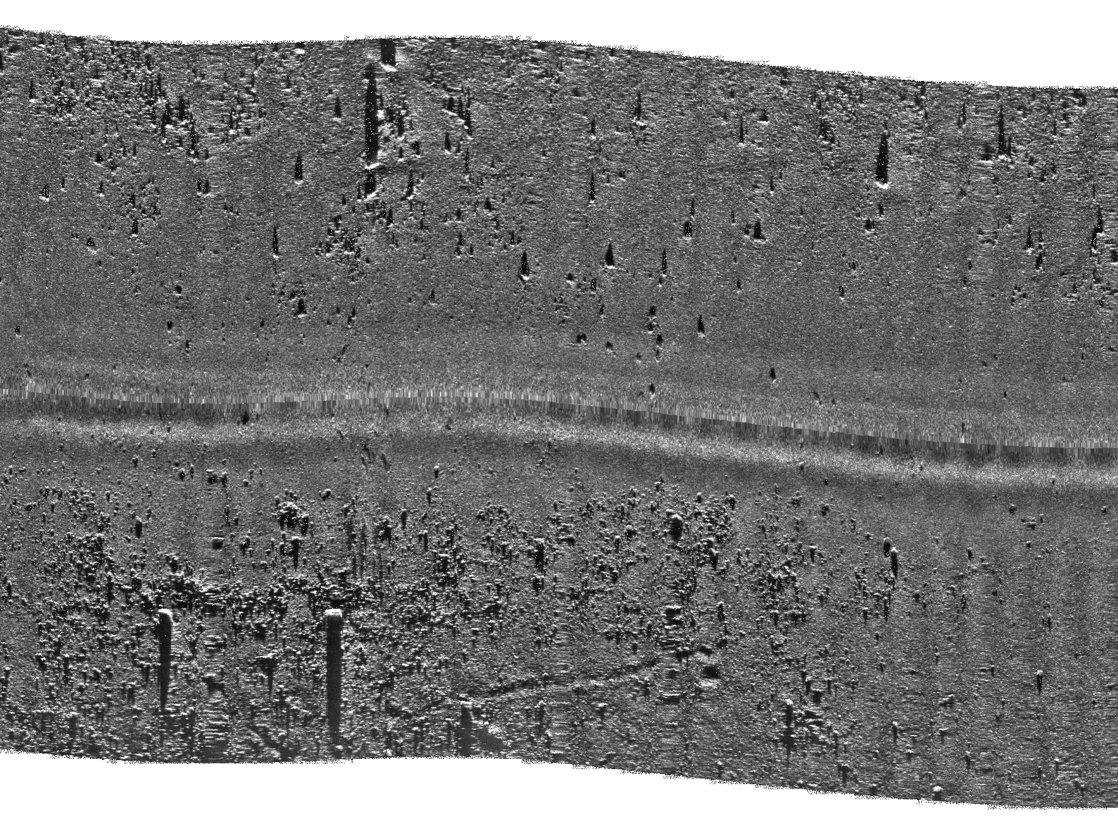
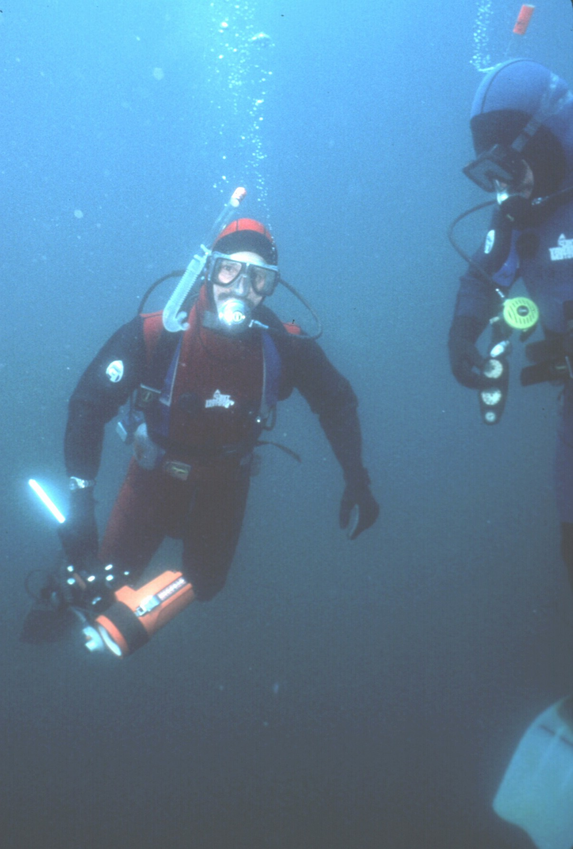
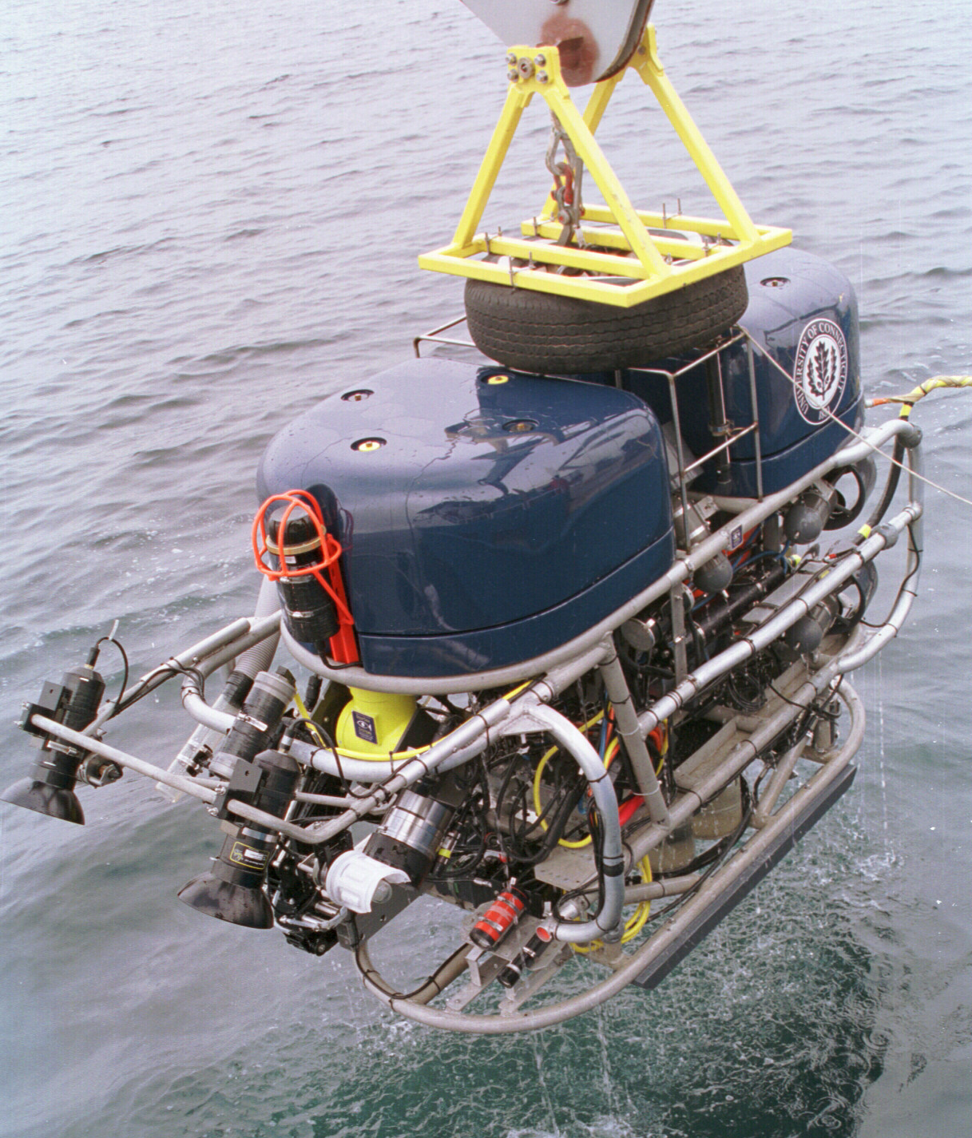
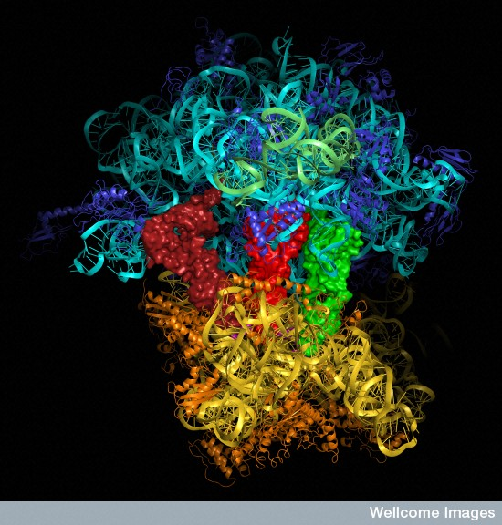
COSEE-TEK Ocean Technology Framework
Years
TIME
Observing Systems
Ships
Ships
Satellites
Gliders
Acoustic tags
Side scan sonar
Multibeam sonar
Divers
ROVs
Molecular & Imaging
Minutes
Meters SPACE 100’s Kms

Slide 7
2011 TTE’s Within the Ocean Technology Framework
Years
“Glide with the Tide”
TIME
Observing Systems
Ships
“The Courtship of EVA & BOB”
Ships
Satellites
Gliders
Acoustic tags
Side scan sonar
Multibeam sonar
Divers
ROVs
Molecular & Imaging
“Hiding in the Light”
Minutes
Meters SPACE 100’s Kms

Slide 8
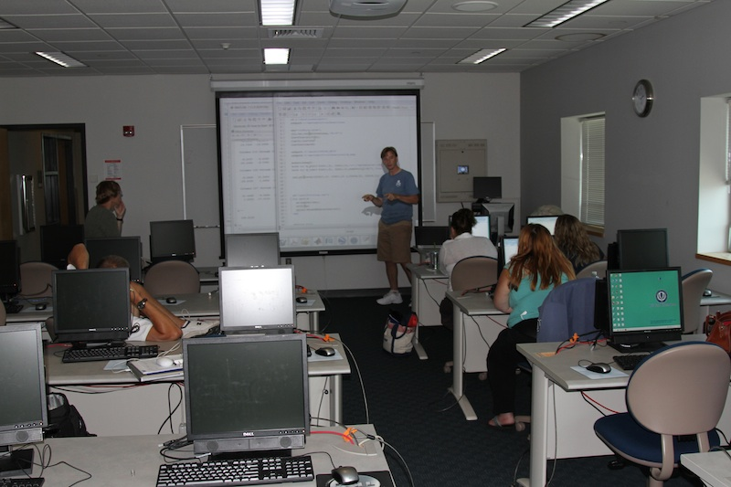
Teacher Technology Experience as a Professional Development Activity
In any discipline, effective professional development should:
Focus on developing teachers’ capabilities and knowledge to teach content and subject matter,
Address teachers’ classroom work and the problems they encounter in their school settings, and
Provide multiple and sustained opportunities for teacher learning over a substantial time interval.
Source: Successful K-12 STEM Education: Identifying Effective Approaches in Science, Technology, Engineering, and Mathematics – National Research Council, 2011

Slide 9
TTEs – Goals & Elements
The goals of the TTE’s:
To improve educators’ technology content knowledge,
Heighten scientists’ awareness of the challenges of science education and outreach
Broaden the impacts of researchers’ science and technology through web-based educational resources.
Elements included:
Educator orientation to research & technologies
Scientist orientation to formal & informal education challenges
Training on technologies and data analysis
Technology field experience – data collection
Data analysis
Educational resource development

Slide 10
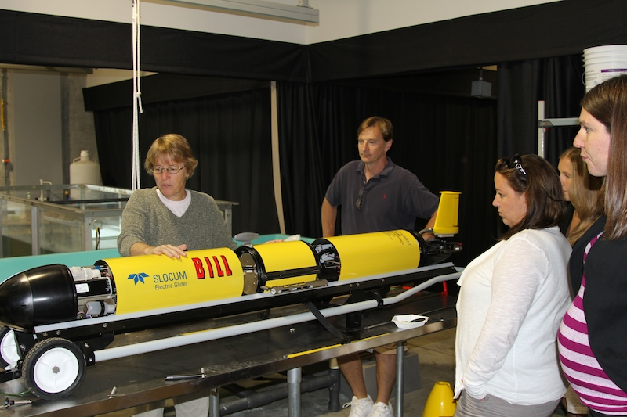
TTE Demographics
9 Formal educators
3 Informal educators
3 Research scientists
4 Technicians
2 Graduate students
1 Undergraduate

Slide 11
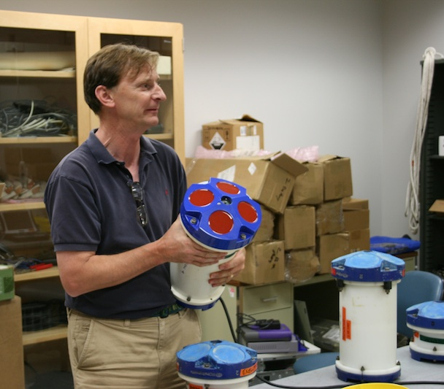
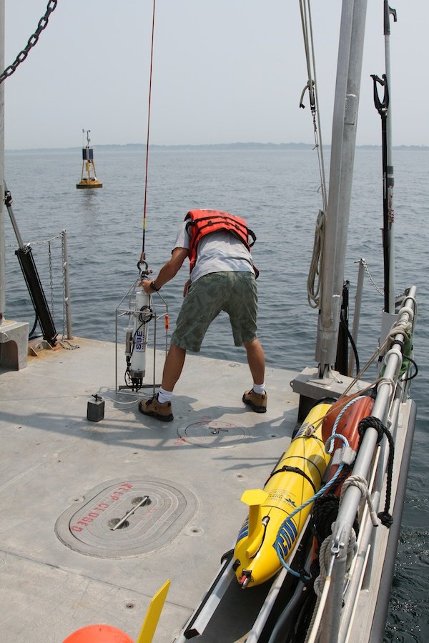
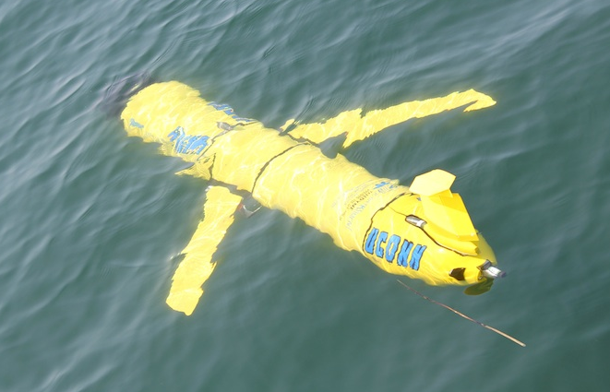
The Technologies & the Team: Glide with the Tide Dr. Jim O’Donnell, Kay Howard-Strobel, Dennis Arbige

Slide 12
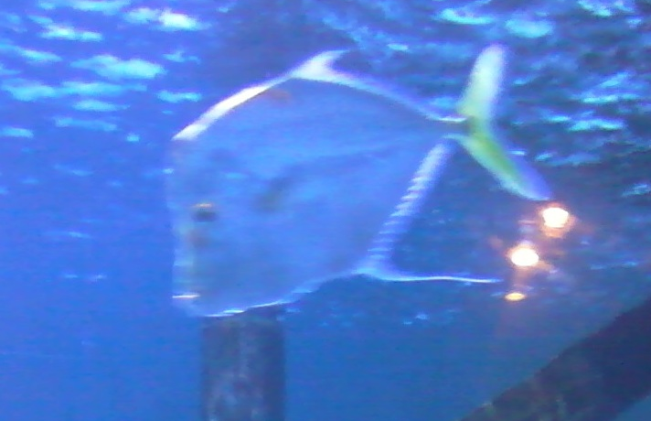
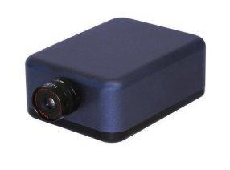
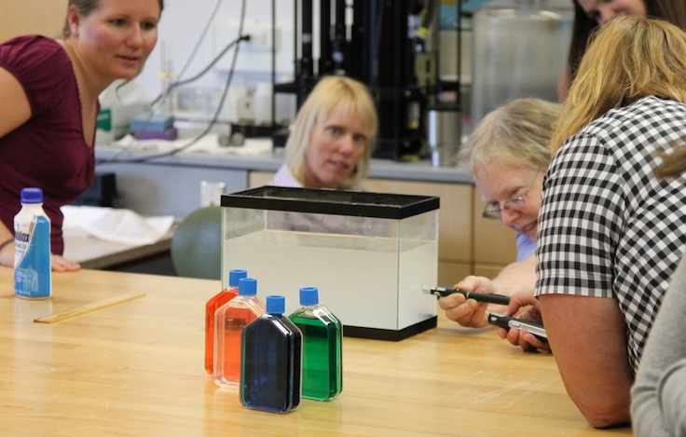
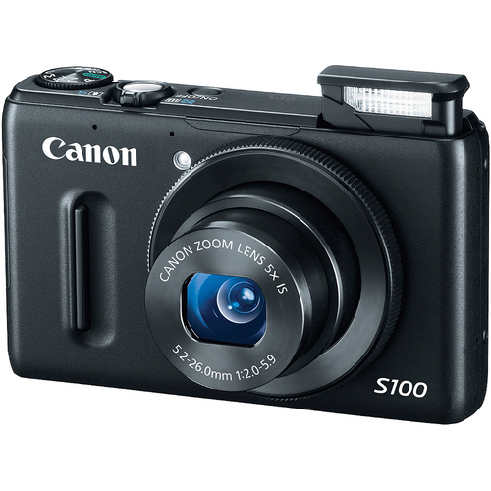
The Technologies & the Team: “Hiding in the Light” Dr. Heidi Dierssen, Kelley Bostrom, Brandon Russell

Slide 13
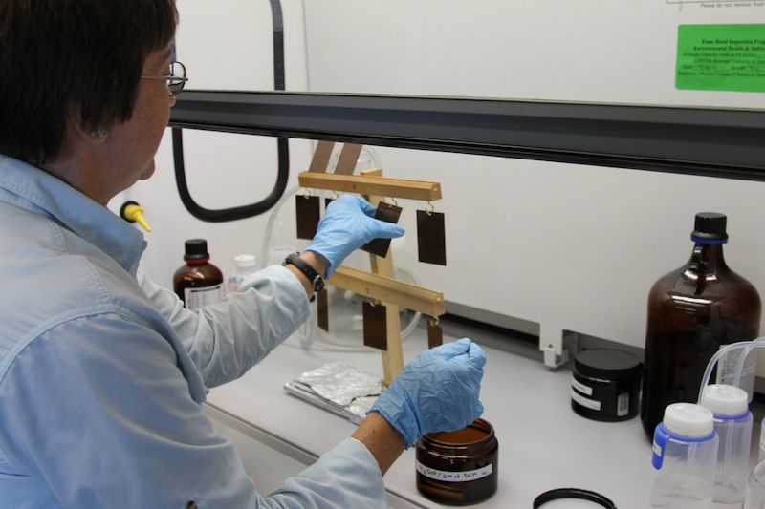
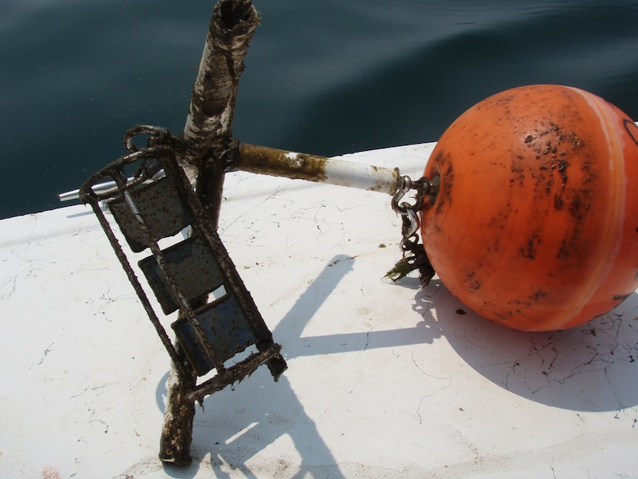
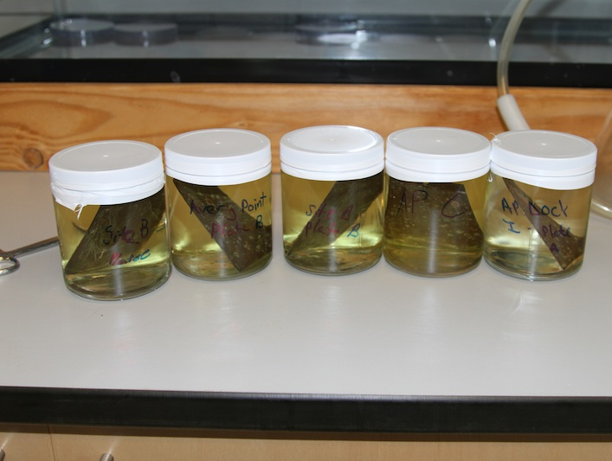
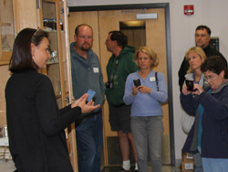
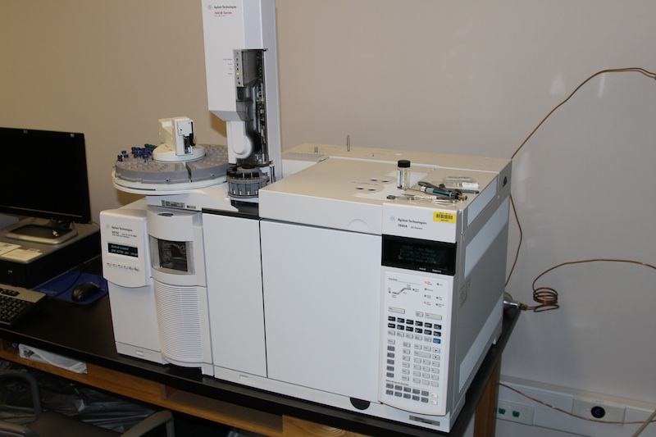
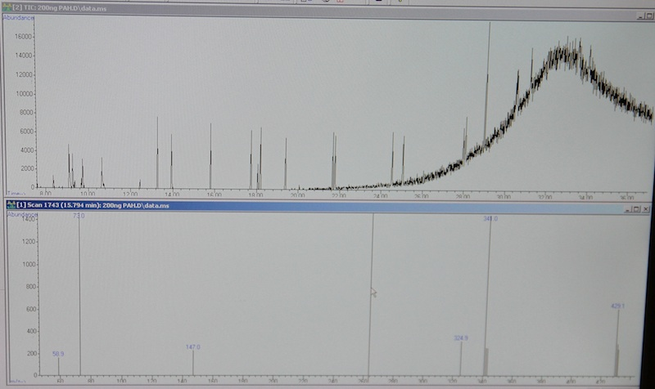
The Technologies & the Team: The Courtship of EVA & BOB Dr. Penny Vlahos, Dr. John Hamilton, David Cady, Kevin Joy
Penny Vlahos – Mother of EVA
Ethylene Vinyl Acetate Passive Chemical Samplers

Slide 14
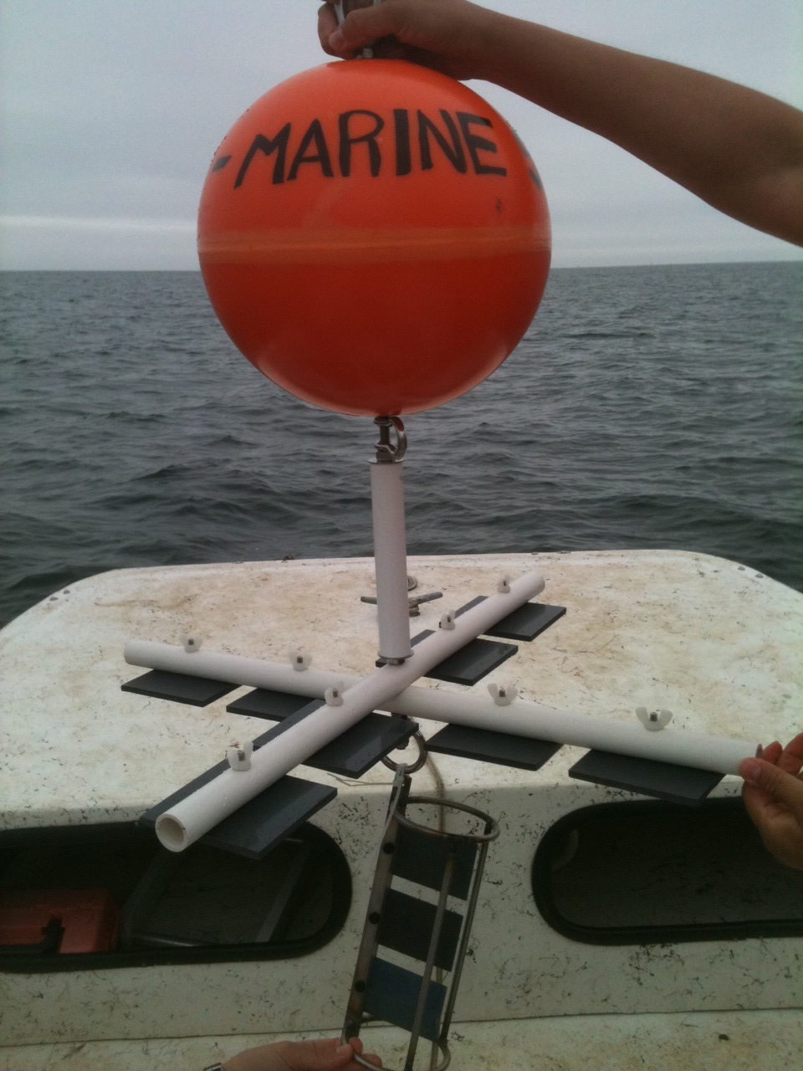
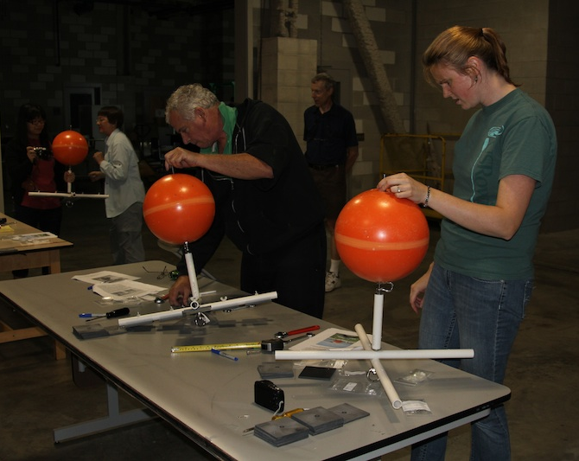
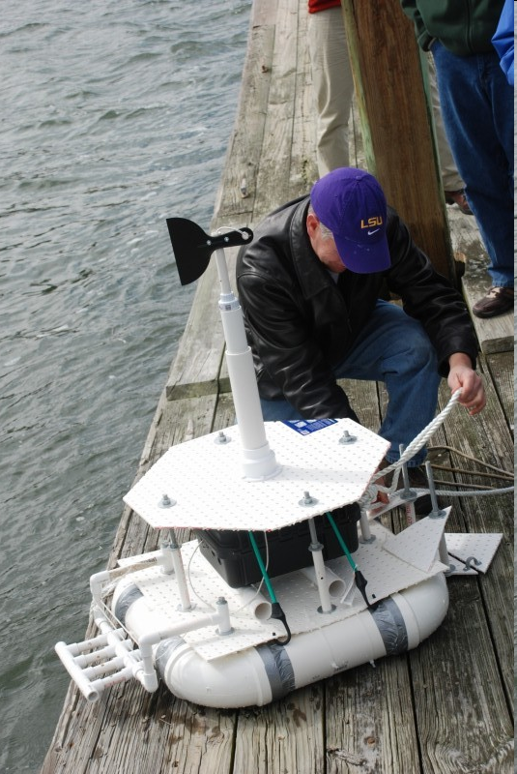
The Technologies Basic Observation Buoys (BOBs)
Father of BOB - Doug Levin, Washington College, PA
COSEE- Southeast
SECOORA
“Form ever follows function” Louis Sullivan, 1896

Slide 15
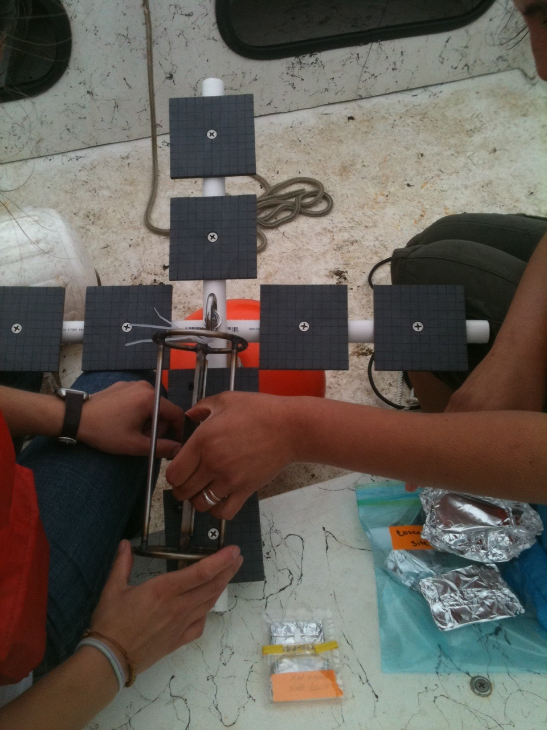
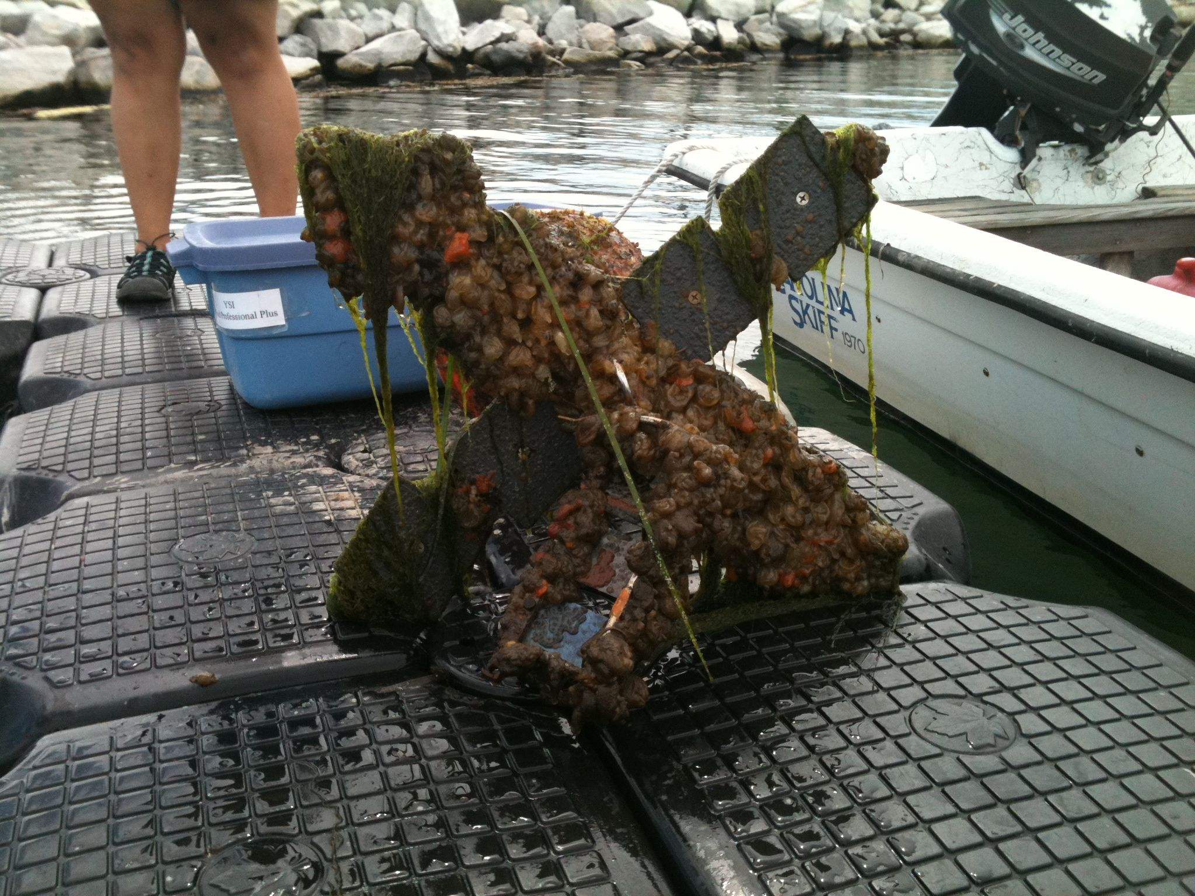
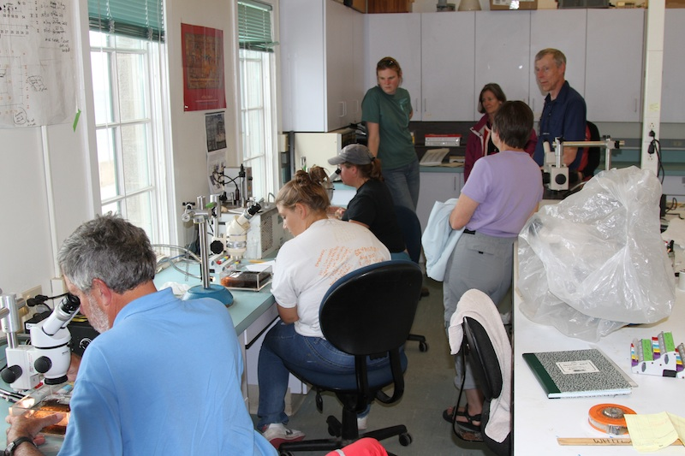
The Technologies: Settling Plates

Slide 16
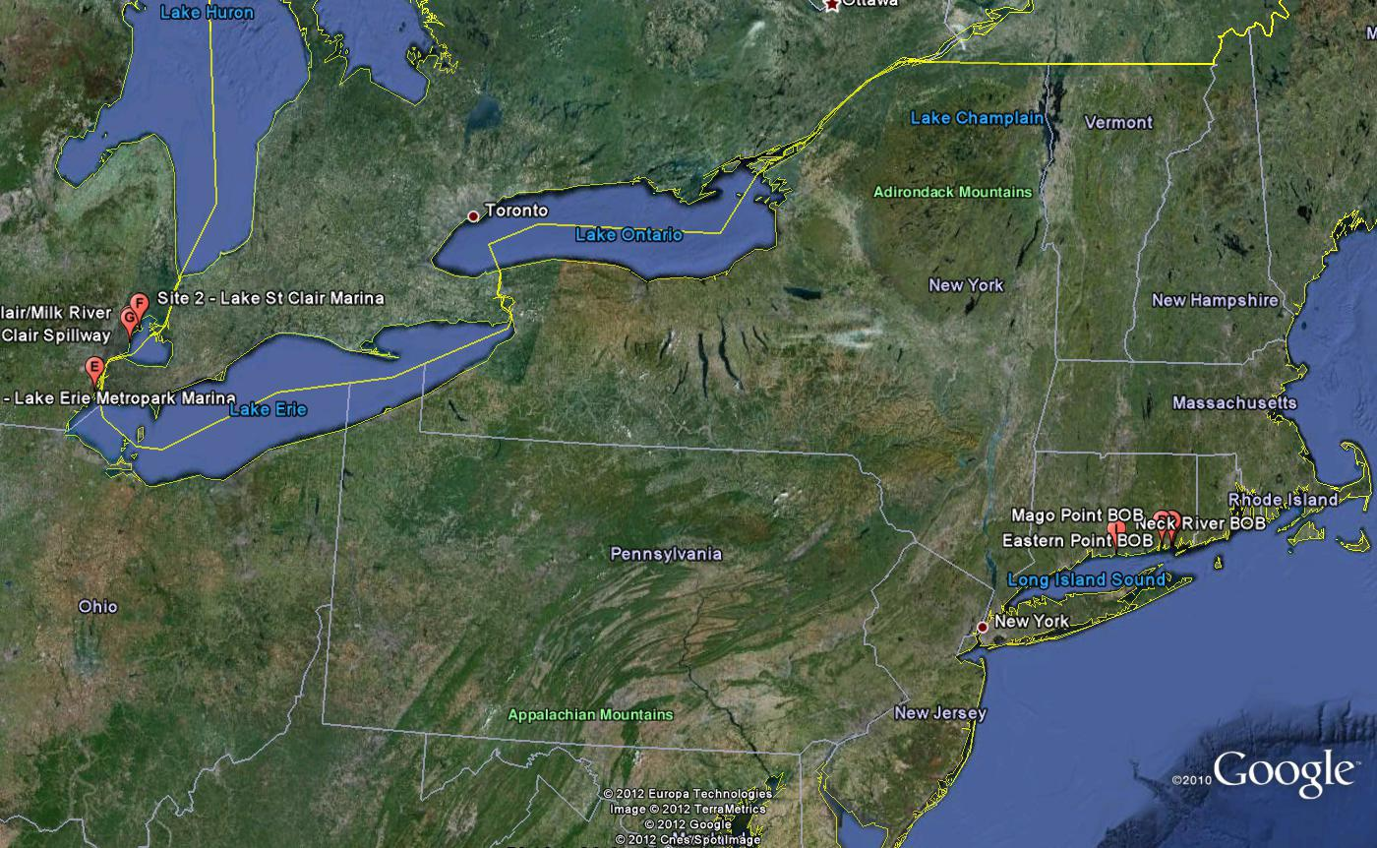
A growing network of BOBs A Community of Practice?
Westhill
High School
Daniel Hand
The Domain – developing a shared competence
The Community – engaging in joint activities, discussions, share information
The Practice – develop a shared repertoire of resources, experiences, tools
Wenger, 2001

Slide 17
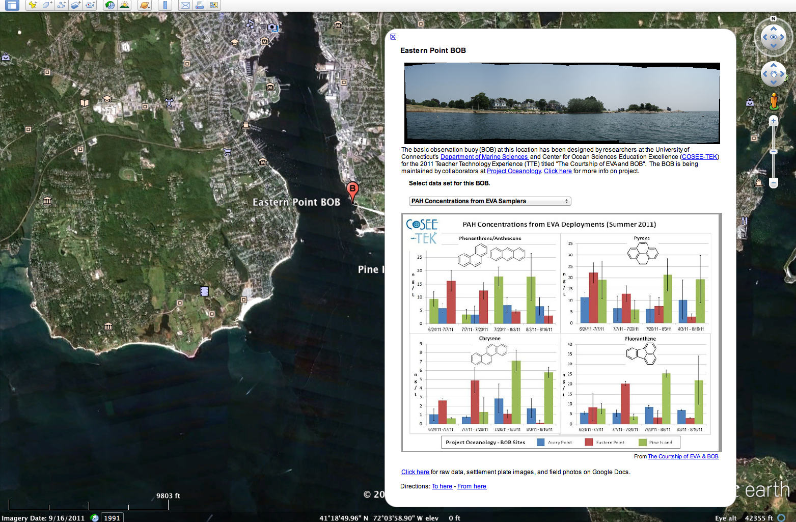
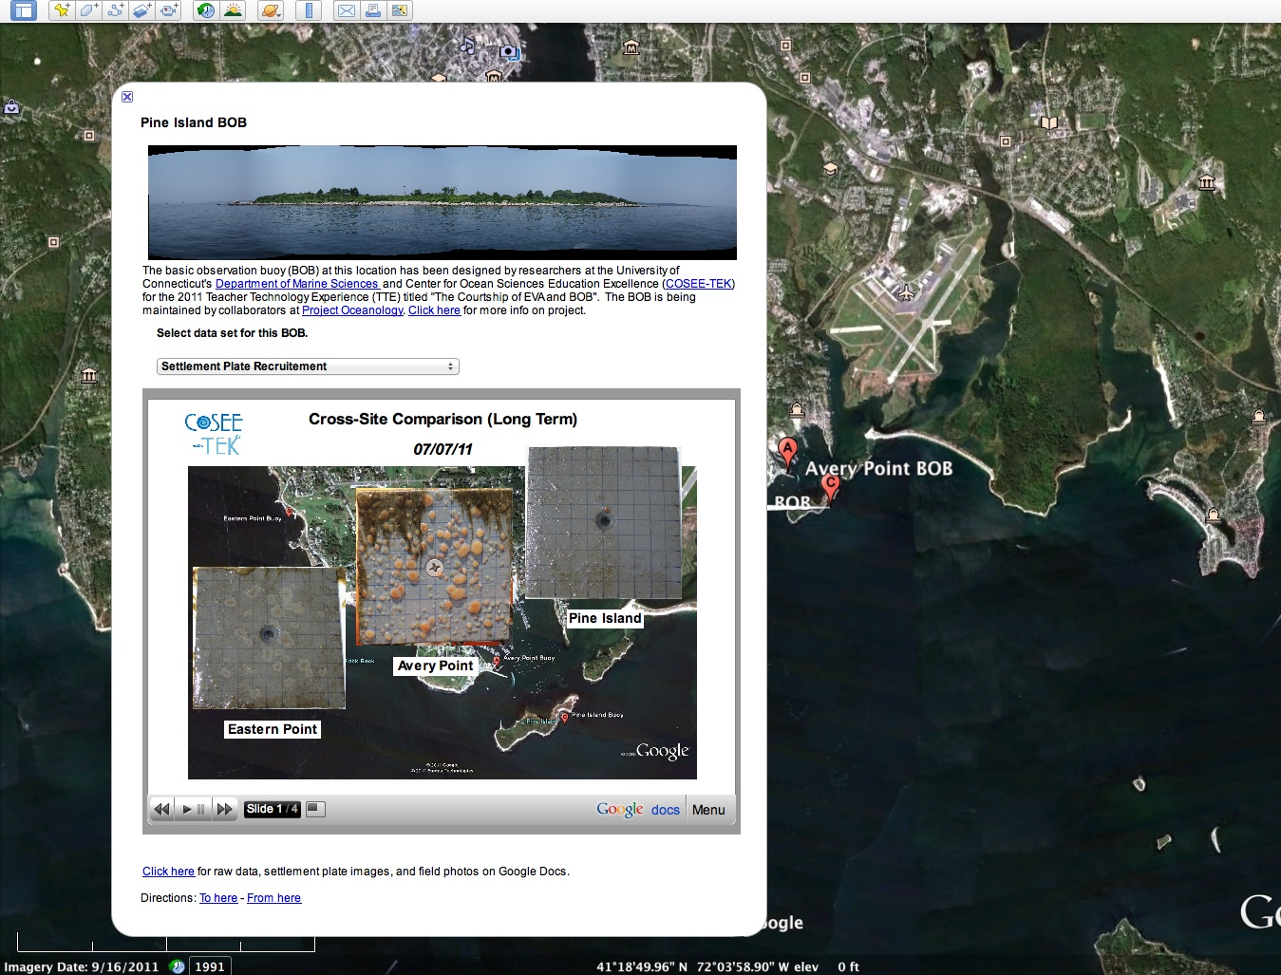
Technologies to Support Communities of Practice
Characteristics of Technology Platforms for Communities of Practice*:
Easy to learn & use
Easily integrated with other commonly used software
Not too expensive
* - Wenger 2001 – “Supporting Communities of Practice: a Survey of Community-oriented Technologies”

Slide 18
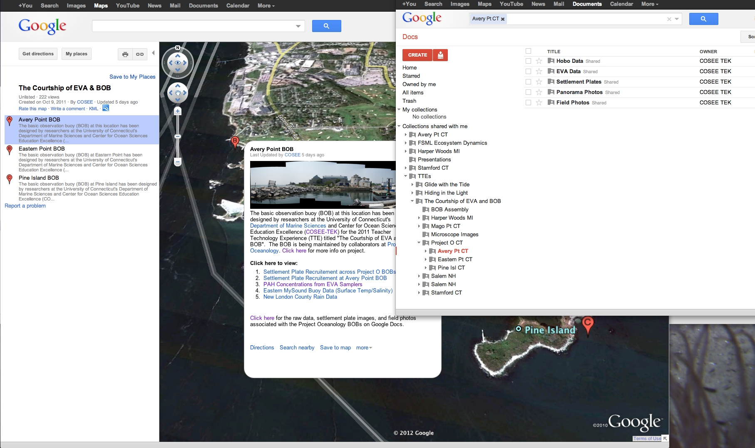
Community-oriented Technologies
“ a shared workspace for synchronous electronic collaboration, discussion, a document repository, community management tools”
* - Wenger 2001 – “Supporting Communities of Practice: a Survey of Community-oriented Technologies”

Slide 19
TTE Evaluation - Methods
Formal and Informal Educators
Ocean technology content pre/post
Based on overview of ocean technology presented to all participants at the start of the program
Concept map pre/post
Allows for TTE-specific quantitative and qualitative analyses
n=12 (4 per TTE)
Scientists/Technicians
Concept map pre/post; n=7
Gliders n=1; Hiding in the Light n=2; EVA & BOB n=4

Slide 20
Ocean Technology Content
Format: Multiple choice, true/false, short answer, ranking
Mean percent change in score:
Glide with the Tide TTE: + 8%
Hiding in the Light TTE: + 14%
EVA & BOB TTE: + 11%
Understanding of ocean technology best reflected in post-test short answers – specific & relevant vs. “I’m not sure” (pre)
Notes:
Percent reported as n=4 – too small sample size for more than descriptive statistics; Done by TTE as each TTE focused on different aspects of technology

Slide 21
Concept Maps - Educators
Root prompt: What do you know about ocean technology?
Mean change in number of concepts:
Glide with the Tide TTE: +16.5
Hiding in the Light TTE: +26.0
EVA & BOB TTE: +16.5
Many pre-maps cited ocean “facts” having little to do with ocean technology
Post-concept maps included specific examples from the TTE experience

Slide 22
Concept Maps - Scientists
Root prompt: What do you know about formal and informal education?
Mean change in number of concepts:
Glide with the Tide TTE (n=1): -3
Focused on own experience/his own children in school
Hiding in the Light TTE (n=2): +10
EVA & BOB TTE (n=4): +8
Post-concept maps reflect discussions between scientists and educators during TTE

Slide 23
Future Considerations
Refinement of Ocean Technology content pre/post to better reflect overview of ocean technology and TTE topics
Follow up with scientists and technicians regarding understanding of how their research can be incorporated into K-12 formal and informal education
Analysis of clusters of concepts (e.g., level, depth, width) and analysis of complexity of the concept map (Walters, 2009)*
*Walters, H. (2009). Concept mapping: Mixed methods data for measuring teacher learning as an NSF –funded professional development program (COSEE Great Lakes). National Forum of Teacher Education Journal; 19:3, 1-16.

Slide 24
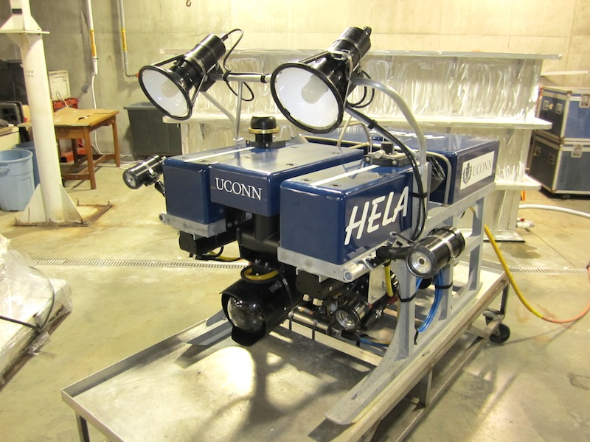
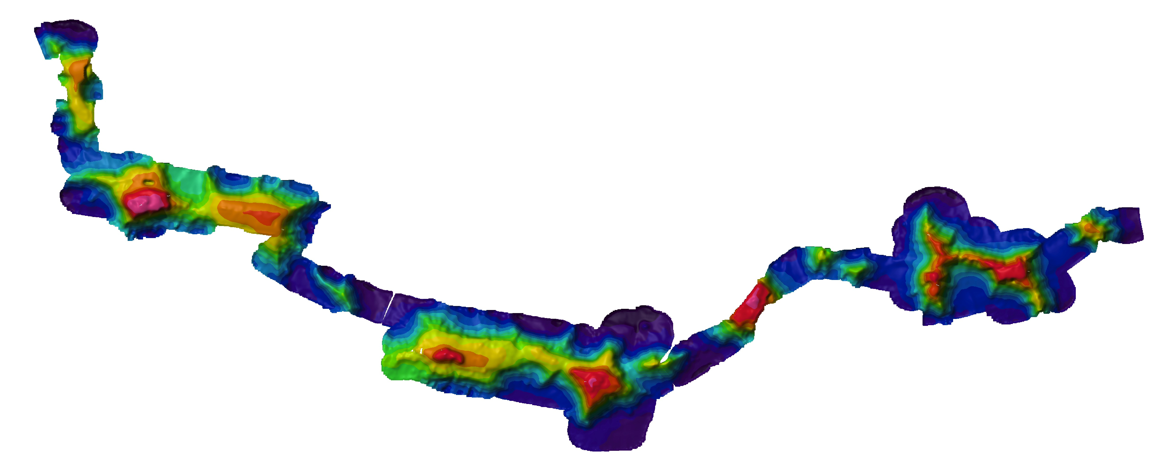
Summary & Future TTEs
TTE’s are an effective professional development activity for educators
TTE’s provide scientists with technology-based broader impacts
Developing a Community of Practice with IT tools
2012 TTE’s will feature:
The expansion of the EVA-BOB relationship
Multibeam & side scan sonars
Remotely Operated Vehicles

